Slide 1

Sikkerhed i Webapplikationer
A full lifecycle approach is the only way to achieve secure software.
–Chris Wysopal

Slide 2
SOFTWARE ER USIKKERT
Hvorfor forbedre vi sikkerheden?
GDPR
Etik, moral og ansvar
Digital Tillid
Økonomi
GDPR ISO 27701
ISS ISO 27001
Etik, moral og ansvar
Brugeren skal føle sig tryg ved brug af software og webapplikationer
Det kan være dyrt og nogle gange alt ødelæggende at have dårlig sikkerhed

Slide 3
PREVENTION IS CHEAPER THAN A CURE
“It is not possible to “test” security into software. The earlier a defect is uncovered, the cheaper it is to fix”
Source: B. Littlewood, Ed., Software Reliability: Achievement and Assesment

Slide 4
SOFTWARE ER USIKKERT
Hvordan forbedrer vi sikkerheden?
Design vulnerabilities
Planlægge, analysere og design
Dårlig eller ingen sikkershedmodel
Manglende AAA
Implementation vulnerabilities
Implementation, testing og integration
Input validering
Svag strukturel sikkerhed

Slide 5
Sikkerhed i Webapplikationer
OWASP top 10
Broken Access Control
Cryptographic Failures
Injection
Insecure Design
Security Misconfiguration
Vulnerable and Outdated Components
Identification and Authentication Failures
Software and Data Integrity Failures
Security Logging and Monitoring Failures
Server-Side Request Forgery

Slide 6





Sikkerhed i Webapplikationer

Slide 7
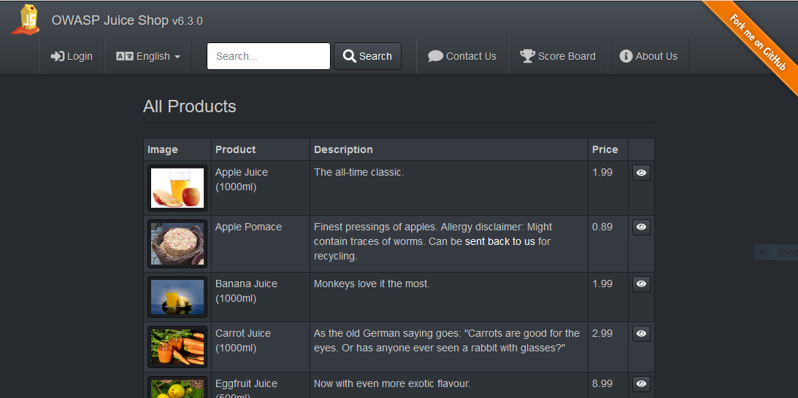
Sikkerhed i Webapplikationer
Lær af andres fejl
JuiceShop

